Slide 1


Bird Strikes Between 2000-2011
By: Riya Patel

Slide 2


Objective
Analyze and Visualize the Data of Bird Strikes Happened between 2000-2011
Benefits
Gives better insight into Bird Strikes Data Visualization.
Help in easy understanding of the data.

Slide 3
Problem Statement
Transport and communication are in the crucial domain in the field of analytics. Environmental impacts and safety are, nowadays, two major concerns of the scientific community with respect to transport scenarios and to the ever-growing urban areas. These issues gain more importance due to the increasing amount of vehicles and people. Seeking new solutions is reaching a point where available technologies and artificial intelligence, especially MAS, are being recognized as ways to cope with and tackle these kinds of problems in a distributed and more appropriate way.
A bird strike is strictly defined as a collision between a bird and an aircraft which is in flight or on a take-off or landing roll. The term is often expanded to cover other wildlife strikes - with bats or ground animals. Bird Strike is common and can be a significant threat to aircraft safety. For smaller aircraft, significant damage may be caused to the aircraft structure and all aircraft, especially jet-engine ones, are vulnerable to the loss of thrust which can follow the ingestion of birds into engine air intakes. This has resulted in several fatal accidents.
Bird strikes may occur during any phase of flight, but are most likely during the take-off, initial climb, approach and landing phases due to the greater numbers of birds in flight at lower levels. To have a closer look the following document visually depicts the data collected on Bird Strikes by FAA between 2000-2011.

Slide 4
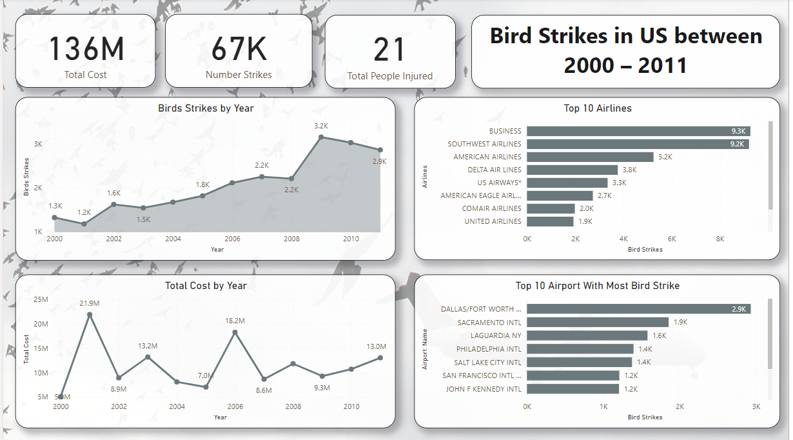
Visualization

Slide 5
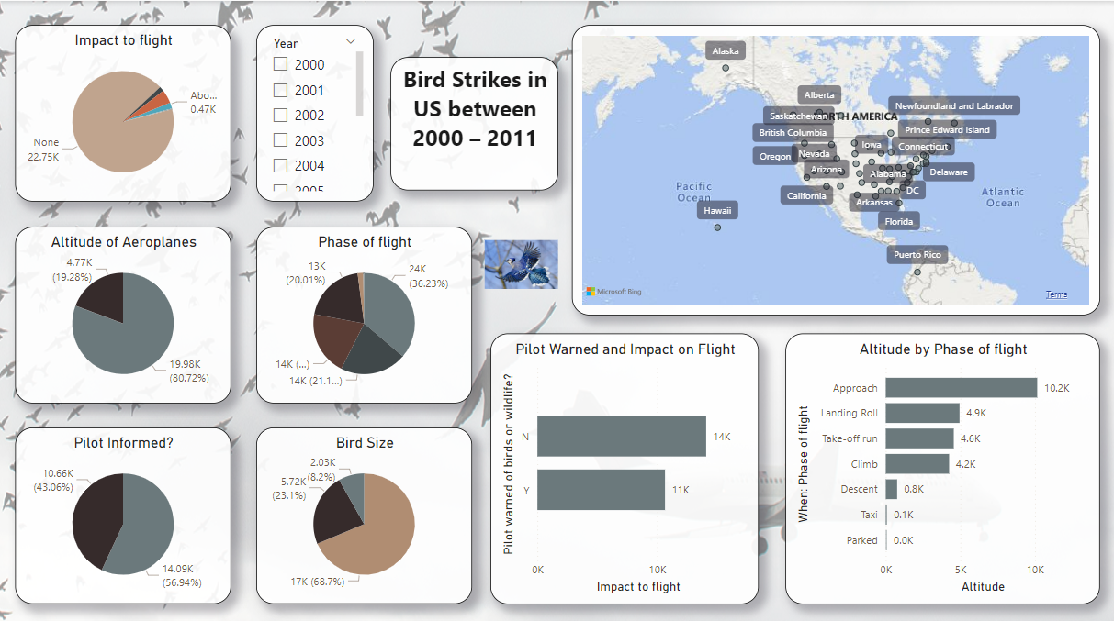

Slide 6
Conclusion
The entire cost is 136 million.
There have been 67 K strikes overall.
There were twenty-one injured in all.
With 3152 Bird Strikes, 2009 has the most strikes.
The top two airlines are Business and Southwest Airlines, in that order.
The most expensive year was 2001, at $21.9 million.
The airport with the highest number of bird strikes is Dallas/Fort Worth.

